Slide 1
CME 2003 Digital Logic
Combinational Circuits
MSI Components

Slide 2
Combinational Circuits: MSI Components
Useful MSI circuits
Decoders
Implementing Functions with Decoders
Decoders with Enable
Larger Decoders
Standard MSI Decoders
Implementing Functions with Decoders (2)
Combinational Circuits: MSI Components

Slide 3
Combinational Circuits: MSI Components
Encoder
Demultiplexer
Multiplexer
Multiplexer IC Package
Larger Multiplexers
Standard MSI Multiplexer
Implementing Functions with Multiplexers
Implementing Functions with Smaller Multiplexers
Combinational Circuits: MSI Components

Slide 4
Useful MSI circuits
Four common and useful MSI circuits are:
  Decoder
  Demultiplexer
  Encoder
  Multiplexer
Block-level outlines of MSI circuits:
decoder
encoder
code
entity
entity
code
mux
data
data
demux
output
input
select
select
Combinational Circuits: MSI Components

Slide 5
Decoders (1/5)
Codes are frequently used to represent entities, e.g. your name is a code to denote yourself (an entity!).
These codes can be identified (or decoded) using a decoder. Given a code, identify the entity.
Convert binary information from n input lines to (max. of) 2^{n} output lines.
Known as n-to-m-line decoder, or simply n:m or n×m decoder (m ≤ 2^{n}).
May be used to generate 2^{n} (or fewer) minterms of n input variables.
Combinational Circuits: MSI Components

Slide 6
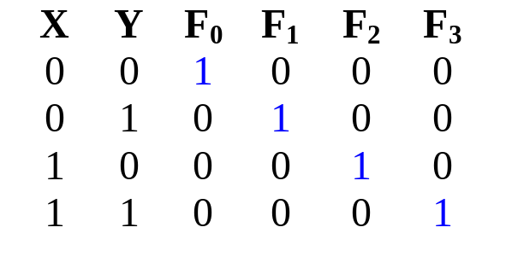
Decoders (2/5)
Example: if codes 00, 01, 10, 11 are used to identify four light bulbs, we may use a 2-bit decoder:
2x4
Dec
F₀ F₁ F₂ F₃
Bulb 0
Bulb 1
Bulb 2
Bulb 3
2-bit code
X
Y
This is a 2×4 decoder which selects an output line based on the 2-bit code supplied.
Truth table:
Combinational Circuits: MSI Components

Slide 7
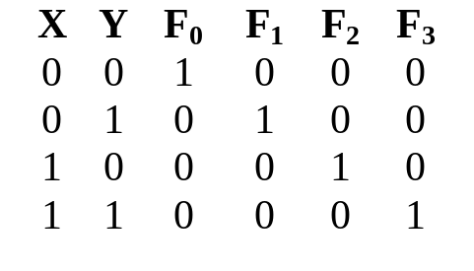
Decoders (3/5)
From truth table, circuit for 2×4 decoder is:
Note: Each output is a 2-variable minterm (X'.Y', X'.Y, X.Y' or X.Y)
F₀ = X'.Y'
F₁ = X'.Y
F₂ = X.Y'
F₃ = X.Y
X
Y
Combinational Circuits: MSI Components

Slide 8
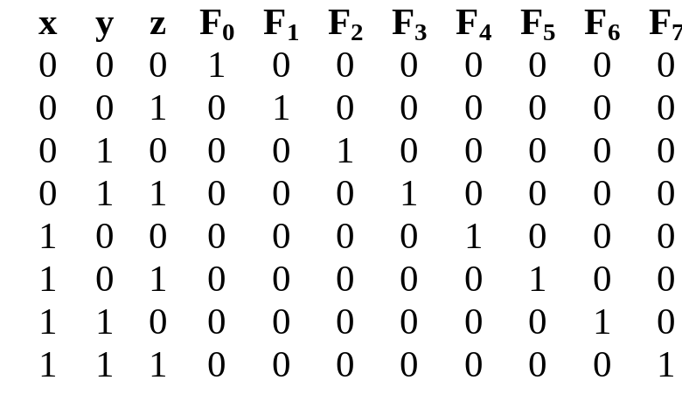
Decoders (4/5)
Design a 3×8 decoder.
F₀ = x'.y'.z'
F₁ = x'.y'.z
F₂ = x'.y.z'
F₃ = x'.y.z
F₄ = x.y'.z'
F₅ = x.y'.z
Application? Binary-to-octal conversion.
F₆ = x.y.z'
F₇ = x.y.z
x
y
z
Combinational Circuits: MSI Components

Slide 9
Decoders (5/5)
In general, for an n-bit code, a decoder could select up to 2^{n} lines:
n-bit
code
n to 2^{n}
decoder
up to 2^{n}
output lines
:
:
Combinational Circuits: MSI Components

Slide 10
Decoders: Implementing Functions (1/5)
A Boolean function, in sum-of-minterms form  decoder to generate the minterms, and an OR gate to form the sum.
Any combinational circuit with n inputs and m outputs can be implemented with an n:2^{n} decoder with m OR gates.
Good when circuit has many outputs, and each function is expressed with few minterms.
Combinational Circuits: MSI Components

Slide 11
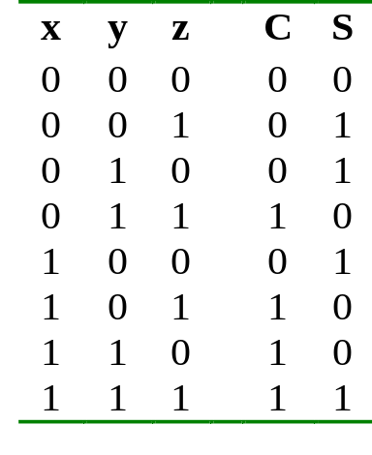
Decoders: Implementing Functions (2/5)
Example: Full adder
  S(x, y, z) = Σ m(1,2,4,7)
  C(x, y, z) = Σ m(3,5,6,7)
3x8
Dec
0
1
2
3
4
5
6
7
S
x
S₂
S₁
S₀
y
z
C
Lecture 3
Combinational Circuits: MSI Components

Slide 12
Decoders: Implementing Functions (3/5)
3x8
Dec
0
1
2
3
4
5
6
7
1
0
0
0
0
0
0
0
S
0
0
0
0
x
S₂
S₁
S₀
y
C
0
z
Lecture 3
Combinational Circuits: MSI Components

Slide 13
Decoders: Implementing Functions (4/5)
3x8
Dec
0
1
2
3
4
5
6
7
0
1
0
0
0
0
0
0
S
1
0
0
1
x
S₂
S₁
S₀
y
C
0
z
Lecture 3
Combinational Circuits: MSI Components

Slide 14
Decoders: Implementing Functions (5/5)
3x8
Dec
0
1
2
3
4
5
6
7
0
0
0
0
0
0
0
1
S
1
1
1
1
x
S₂
S₁
S₀
y
C
1
z
Lecture 3
Combinational Circuits: MSI Components

Slide 15
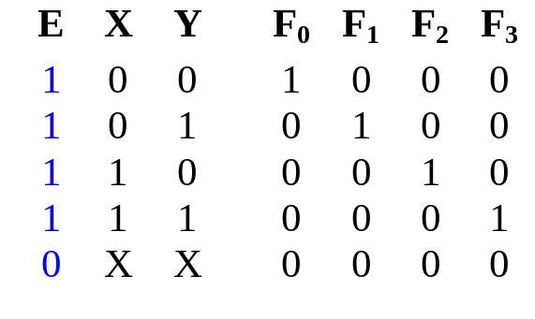
Decoders with Enable (1/2)
Decoders often come with an enable signal, so that the device is only activated when the enable, E=1.
Truth table:
F₀ = EX'Y'
F₁ = EX'Y
F₂ = EXY'
F₃ = EXY
Circuit:
X
Y
E
Lecture 3
Combinational Circuits: MSI Components

Slide 16
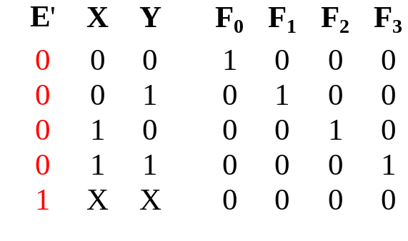
Decoders with Enable (2/2)
In the previous slide, the decoder has a one-enable signal, that is, the decoder is enabled with E=1.
In most MSI decoders, enable signal is zero-enable, usually denoted by E’ (or E). The decoder is enabled when the signal is zero.
Decoder with 1-enable
Decoder with 0-enable
Lecture 3
Combinational Circuits: MSI Components

Slide 17
Larger Decoders (1/6)
Larger decoders can be constructed from smaller ones.
For example, a 3-to-8 decoder can be constructed from two 2-to-4 decoders (with one-enable), as follows:
3x8
Dec
0
1
:
:
7
F₀ = w'x'y'
F₁ = w'x'y
:
:
F₇ = wxy
w
x
y
S₂
S₁
S₀
2x4
Dec
w
x
y
0
1
2
3
F₀ = w'x'y'
F₁ = w'x'y
F₂ = w'xy'
F₃ = w'xy
S₁
S₀
E
2x4
Dec
0
1
2
3
F₄ = wx'y'
F₅ = wx'y
F₆ = wxy'
F₇ = wxy
S₁
S₀
E
Lecture 3
Combinational Circuits: MSI Components

Slide 18
Larger Decoders (2/6)
3x8
Dec
0
1
:
:
7
F₀ = w'x'y'
F₁ = w'x'y
:
:
F₇ = wxy
w
x
y
S₂
S₁
S₀
0
0
0
2x4
Dec
1
0
0
0
w
x
y
0
1
2
3
F₀ = w'x'y'
F₁ = w'x'y
F₂ = w'xy'
F₃ = w'xy
S₁
S₀
E
1 = enabled
2x4
Dec
0
0
0
0
0
1
2
3
F₄ = wx'y'
F₅ = wx'y
F₆ = wxy'
F₇ = wxy
S₁
S₀
E
0 = disabled
Lecture 3
Combinational Circuits: MSI Components

Slide 19
Larger Decoders (3/6)
3x8
Dec
0
1
:
:
7
F₀ = w'x'y'
F₁ = w'x'y
:
:
F₇ = wxy
w
x
y
S₂
S₁
S₀
0
0
1
2x4
Dec
0
1
0
0
w
x
y
0
1
2
3
F₀ = w'x'y'
F₁ = w'x'y
F₂ = w'xy'
F₃ = w'xy
S₁
S₀
E
1 = enabled
2x4
Dec
0
0
0
0
0
1
2
3
F₄ = wx'y'
F₅ = wx'y
F₆ = wxy'
F₇ = wxy
S₁
S₀
E
0 = disabled
Lecture 3
Combinational Circuits: MSI Components

Slide 20
Larger Decoders (4/6)
3x8
Dec
0
1
:
:
7
F₀ = w'x'y'
F₁ = w'x'y
:
:
F₇ = wxy
w
x
y
S₂
S₁
S₀
1
1
0
2x4
Dec
0
0
0
0
w
x
y
0
1
2
3
F₀ = w'x'y'
F₁ = w'x'y
F₂ = w'xy'
F₃ = w'xy
S₁
S₀
E
0 = disabled
2x4
Dec
0
0
1
0
0
1
2
3
F₄ = wx'y'
F₅ = wx'y
F₆ = wxy'
F₇ = wxy
S₁
S₀
E
1 = enabled
Lecture 3
Combinational Circuits: MSI Components

Slide 21
Larger Decoders (5/6)
Construct a 4x16 decoder from two 3x8 decoders with 1-enable.
4x16
Dec
w
x
y
z
S₃
S₂
S₁
S₀
0
1
:
:
15
F₀
F₁
:
:
F₁₅
3x8
Dec
w
x
y
z
0
1
:
7
F₀
F₁
:
F₇
S₂
S₁
S₀
E
3x8
Dec
S₂
S₁
S₀
0
1
:
7
F₈
F₉
:
F₁₅
E
Lecture 3
Combinational Circuits: MSI Components

Slide 22
Larger Decoders (6/6)
Note: The input, w and its complement, w', is used to select either one of the two smaller decoders.
Decoders may also have zero-enable and/or negated outputs. (Normal outputs = active high; negated outputs = active low.)
Exercise: What modifications must be made to provide an ENABLE input for the 3x8 decoder (2 slides ago) and the 4x16 decoder (previous slide) created?
Exercise: How to construct a 4x16 decoder using five 2x4 decoders with enable?
Lecture 3
Combinational Circuits: MSI Components

Slide 23
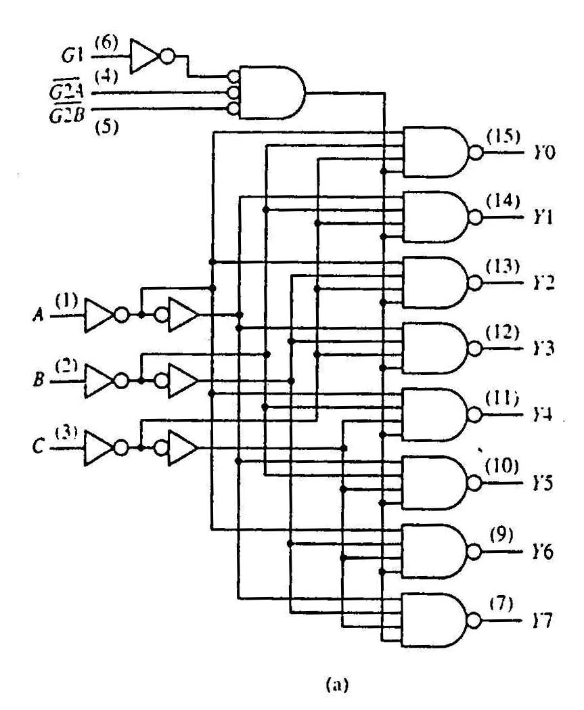
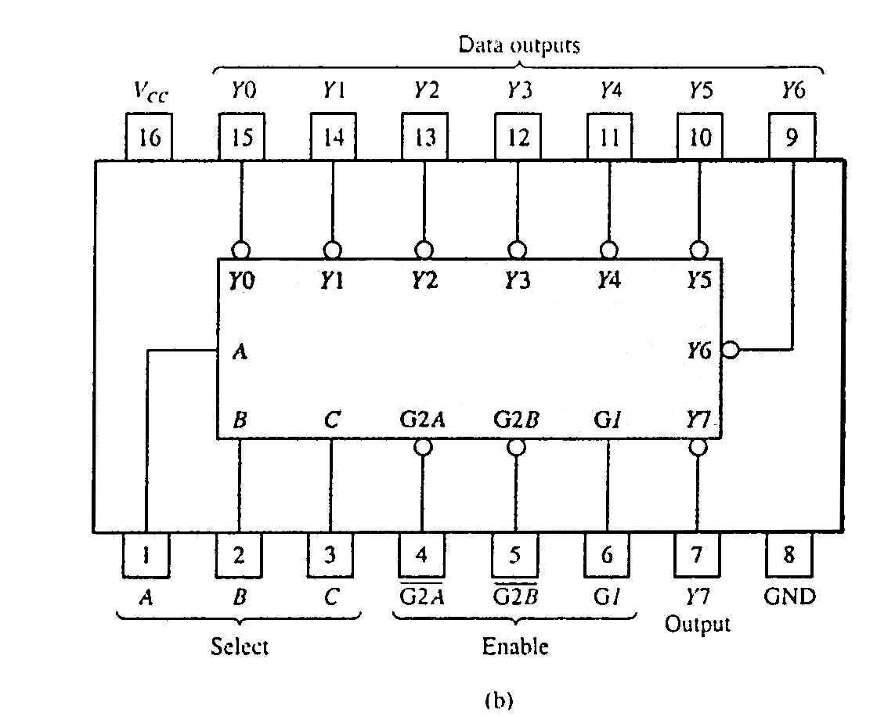
Standard MSI Decoders (1/2)
74138 (3-to-8 decoder)
74138 decoder module.
(a) Logic circuit.
(b) Package pin configuration.
Lecture 3
Combinational Circuits: MSI Components

Slide 24
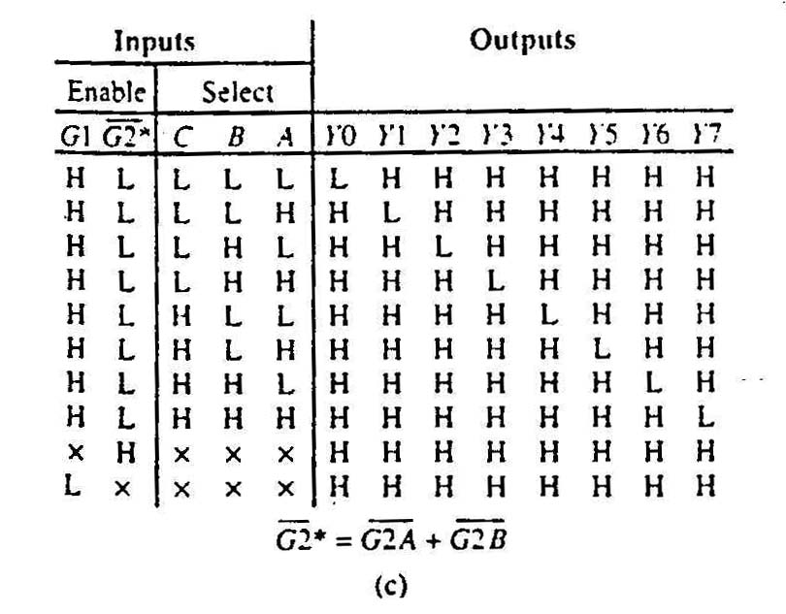
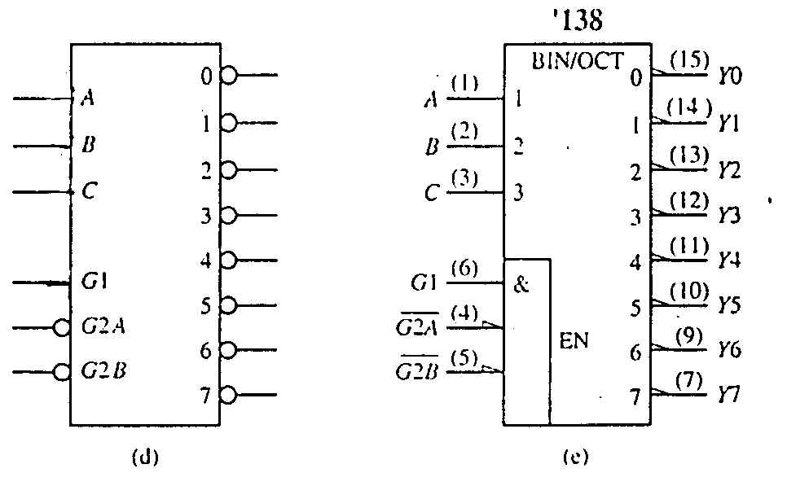
Standard MSI Decoders (2/2)
74138 decoder module.
(c) Function table.
Negated outputs
74138 decoder module.
(d) Generic symbol.
(e) IEEE standard logic symbol.
Source:The Data Book Volume 2, Texas Instruments Inc.,1985
Lecture 3
Combinational Circuits: MSI Components

Slide 25
Decoders: Implementing Functions Revisit (1/2)
Example: Implement the following logic function using decoders and logic gates
f(Q,X,P) = ∑ m(0,1,4,6,7) = ∏ M(2,3,5)
We may implement the function in several ways:
  Use a decoder (with active-high outputs) with an OR gate:
  f(Q,X,P) = m₀ + m₁ + m₄ + m₆ + m₇
  Use a decoder (with active-low outputs) with a NAND gate:
  f(Q,X,P) = ( m₀' . m₁' . m₄' . m₆' . m₇' )'
  Use a decoder (with active-high outputs) with a NOR gate:
  f(Q,X,P) = ( m₂ + m₃ + m₅ )' [ = M₂.M₃.M₅]
  Use a decoder (with active-low outputs) with an AND gate:
  f(Q,X,P) = m₂' . m₃' . m₅'
Lecture 3
Combinational Circuits: MSI Components

Slide 26
Decoders: Implementing Functions Revisit (2/2)
f(Q,X,P)
= ∑ m(0,1,4,6,7)
0
1
2
3
4
5
6
7
0
1
2
3
4
5
6
7
3x8
Dec
3x8
Dec
Q
X
P
A
B
C
f(Q,X,P)
Q
X
P
A
B
C
f(Q,X,P)
(a) Active-high decoder with OR gate.
(b) Active-low decoder with NAND gate.
0
1
2
3
4
5
6
7
0
1
2
3
4
5
6
7
3x8
Dec
3x8
Dec
f(Q,X,P)
f(Q,X,P)
Q
X
P
A
B
C
Q
X
P
A
B
C
(c) Active-high decoder with NOR gate.
(d) Active-low decoder with AND gate.
Lecture 3
Combinational Circuits: MSI Components

Slide 27
Encoder (1/5)
Encoding is the converse of decoding.
Given a set of input lines, where one has been selected, provide a code corresponding to that line.
Contains 2^{n} (or fewer) input lines and n output lines.
Implemented with OR gates.
An example:
F₀
D₀
Select via switches
F₁
4-to-2 Encoder
F₂
2-bits code
F₃
D₁
Lecture 3
Combinational Circuits: MSI Components

Slide 28
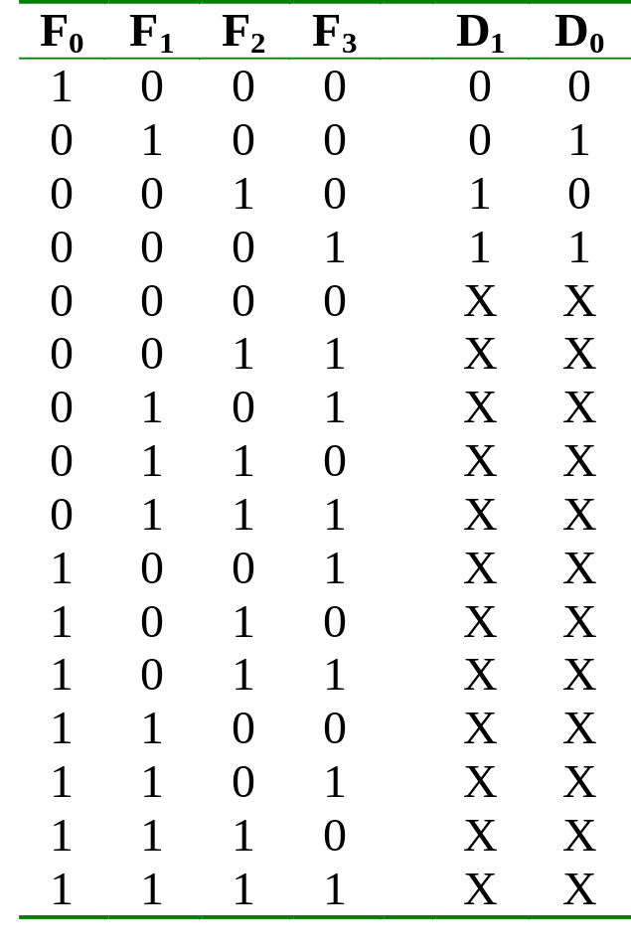
Encoder (2/5)
Truth table:
Lecture 3
Combinational Circuits: MSI Components

Slide 29
Encoder (3/5)
With the help of K-map (and don’t care conditions), can obtain:
D₀ = F1 + F3
D₁ = F2 + F3
which correspond to circuit:
F₀
F₁
D₀
Simple 4-to-2 encoder
F₂
F₃
D₁
Lecture 3
Combinational Circuits: MSI Components

Slide 30
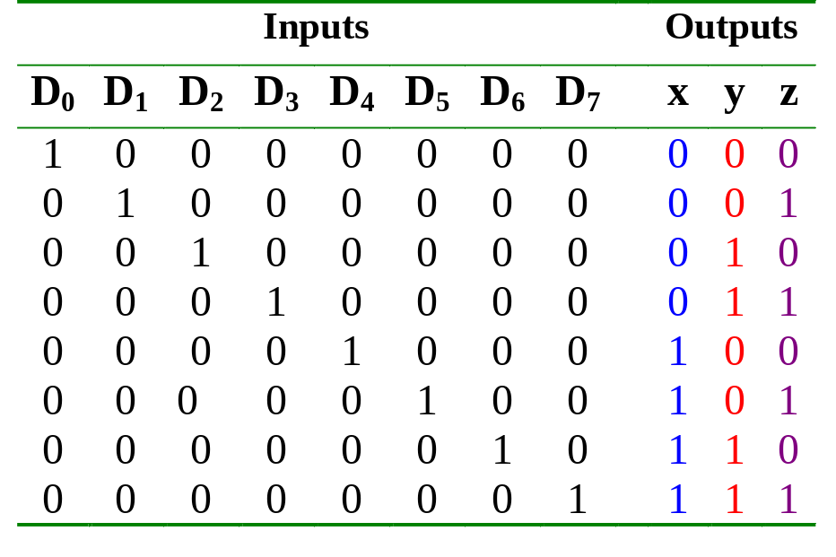
Encoder (4/5)
Example: Octal-to-binary encoder.
  At any one time, only one input line has a value of 1.
  Otherwise, need priority encoder (not covered).
Lecture 3
Combinational Circuits: MSI Components

Slide 31
Encoder (5/5)
Example: Octal-to-binary encoder.
D₀
D₁
D₂
D₃
D₄
D₅
D₆
D₇
x = D₄ + D₅ + D₆ + D₇
y = D₂ + D₃ + D₆ + D₇
z = D₁ + D₃ + D₅ + D₇
An 8-to-3 encoder
Exercise: Can you design a 2^{n}-to-n encoder without the K-map?
Lecture 3
Combinational Circuits: MSI Components

Slide 32
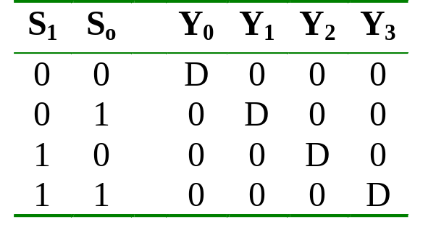
Demultiplexer (1/2)
Given an input line and a set of selection lines, the demultiplexer will direct data from input to a selected output line.
An example of a 1-to-4 demultiplexer:
Outputs
Y₀ = D.S₁'.S₀'
Y₁ = D.S₁'.S₀
Data D
demux
Y₂ = D.S₁.S₀'
Y₃ = D.S₁.S₀
S₁ S₀
select
Lecture 3
Combinational Circuits: MSI Components

Slide 33
Demultiplexer (2/2)
The demultiplexer is actually identical to a decoder with enable, as illustrated below:
Y₀ = D.S₁'.S₀'
2x4 Decoder
S₁
S₀
Y₁ = D.S₁'.S₀
Y₂ = D.S₁.S₀'
E
Y₃ = D.S₁.S₀
D
Exercise: Provide the truth table for above demultiplexer.
Lecture 3
Combinational Circuits: MSI Components

Slide 34
Multiplexer (1/5)
A multiplexer is a device which has
(i) a number of input lines
(ii) a number of selection lines
(iii) one output line
It steers one of 2^{n} inputs to a single output line, using n selection lines. Also known as a data selector.
2^{n}:1
Multiplexer
inputs
output
:
...
select
Lecture 3
Combinational Circuits: MSI Components

Slide 35
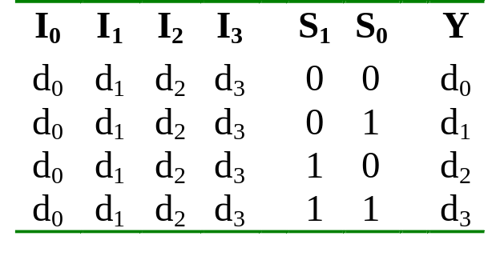
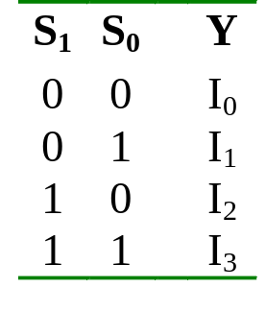
Multiplexer (2/5)
Truth table for a 4-to-1 multiplexer:
Inputs
Inputs
I₀
0
1
2
3
I₀
I₁
4:1
MUX
I₁
I₂
Y
Output
I₂
mux
Y
I₃
I₃
S₁ S₀
S₁ S₀
select
select
Lecture 3
Combinational Circuits: MSI Components

Slide 36
Multiplexer (3/5)
Output of multiplexer is
“sum of the (product of data lines and selection lines)”
Example: the output of a 4-to-1 multiplexer is:
Y = I₀.(S₁'.S₀') + I₁.(S₁'.S₀) + I₂.(S₁.S₀') + I₃.(S₁.S₀)
A 2^{n}-to-1-line multiplexer, or simply 2^{n}:1 MUX, is made from an n: 2^{n} decoder by adding to it 2^{n} input lines, one to each AND gate.
Lecture 3
Combinational Circuits: MSI Components

Slide 37
Multiplexer (4/5)
I₀
I₀
I₁
I₁
Y
Y
I₂
I₂
I₃
I₃
0 1 2 3
2-to-4 Decoder
S₁
S₀
S₁
S₀
Four-to-one multiplexer design.
Lecture 3
Combinational Circuits: MSI Components

Slide 38
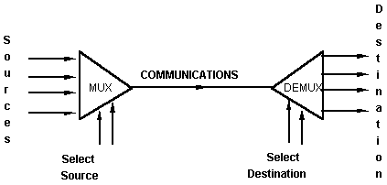
Multiplexer (5/5)
An application:
Helps share a single communication line among a number of devices.
At any time, only one source and one destination can use the communication line.
Lecture 3
Combinational Circuits: MSI Components

Slide 39
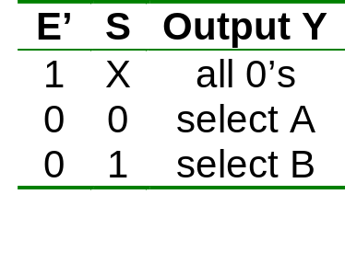
Multiplexer IC Package
Some IC packages have a few multiplexers in each package. The selection and enable inputs are common to all multiplexers within the package.
A₀
A₁
A₂
A₃
Y₀
Y₁
Y₂
Y₃
B₀
B₁
B₂
B₃
S
(select)
Quadruple 2:1 multiplexer
E'
(enable)
Lecture 3
Combinational Circuits: MSI Components

Slide 40
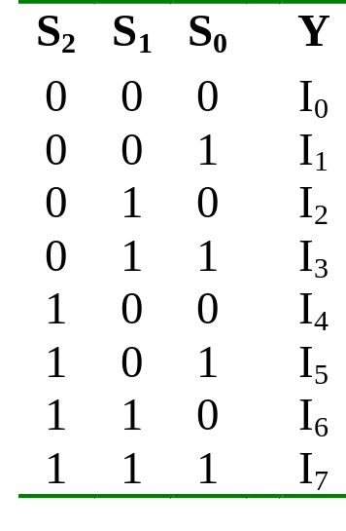
Larger Multiplexers (1/6)
Larger multiplexers can be constructed from smaller ones.
An 8-to-1 multiplexer can be constructed from smaller multiplexers like this (note placement of selector lines):
I₀
I₁
I₂
I₃
4:1 MUX
2:1 MUX
S₁ S₀
Y
I₄
I₅
I₆
I₇
4:1 MUX
S₂
S₁ S₀
Lecture 3
Combinational Circuits: MSI Components

Slide 41
Larger Multiplexers (2/6)
When
S₂S₁S₀ = 000
I₀
I₁
I₂
I₃
4:1 MUX
I₀
I₀
2:1 MUX
S₁ S₀
Y
I₄
I₅
I₆
I₇
4:1 MUX
I₄
S₂
S₁ S₀
Lecture 3
Combinational Circuits: MSI Components

Slide 42
Larger Multiplexers (3/6)
When
S₂S₁S₀ = 001
I₀
I₁
I₂
I₃
4:1 MUX
I₁
I₁
2:1 MUX
S₁ S₀
Y
I₄
I₅
I₆
I₇
4:1 MUX
I₅
S₂
S₁ S₀
Lecture 3
Combinational Circuits: MSI Components

Slide 43
Larger Multiplexers (4/6)
When
S₂S₁S₀ = 110
I₀
I₁
I₂
I₃
4:1 MUX
I₂
I₆
2:1 MUX
S₁ S₀
Y
I₄
I₅
I₆
I₇
4:1 MUX
I₆
S₂
S₁ S₀
Lecture 3
Combinational Circuits: MSI Components

Slide 44
Larger Multiplexers (5/6)
Another implementation of an 8-to-1 multiplexer using smaller multiplexers:
When
S₂S₁S₀ = 000
I₀
I₁
2:1 MUX
I₀
I₂
I₃
2:1 MUX
I₂
S₀
4:1 MUX
I₀
S₀
Y
I₄
I₅
2:1 MUX
I₄
S₂ S₁
S₀
I₆
I₇
2:1 MUX
I₆
Q: Can we use only 2:1 multiplexers?
S₀
Lecture 3
Combinational Circuits: MSI Components

Slide 45
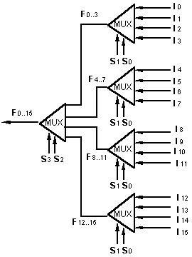
Larger Multiplexers (6/6)
A 16-to-1 multiplexer can be constructed from five 4-to-1 multiplexers:
Lecture 3
Combinational Circuits: MSI Components

Slide 46
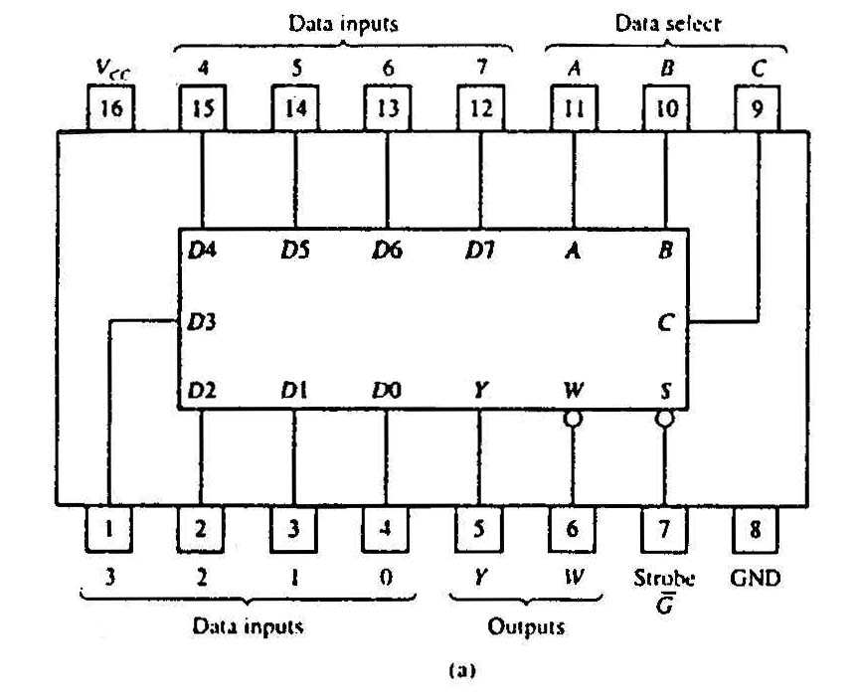
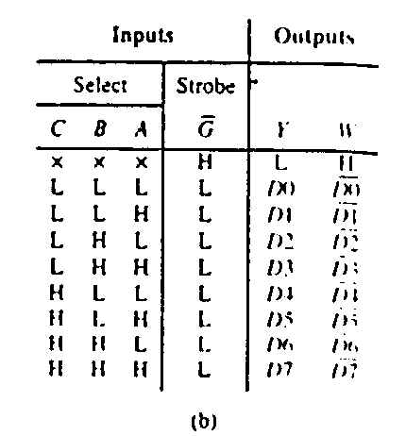
Standard MSI Multiplexer (1/2)
74151A 8-to-1 multiplexer. (a) Package configuration. (b) Function table.
Lecture 3
Combinational Circuits: MSI Components

Slide 47
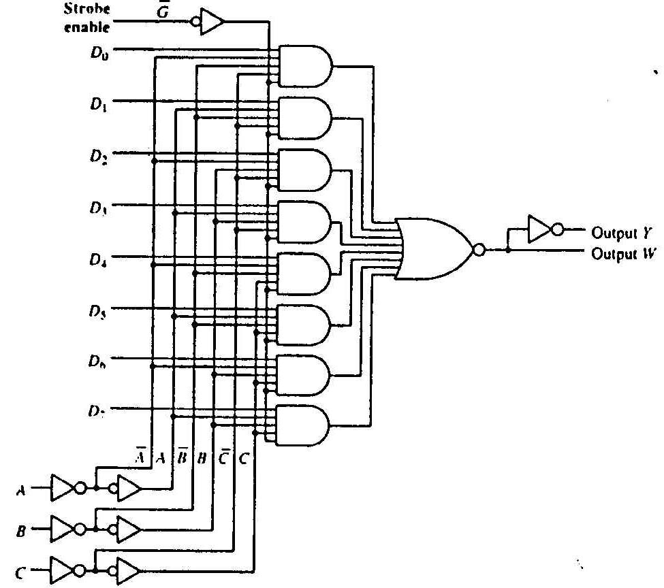
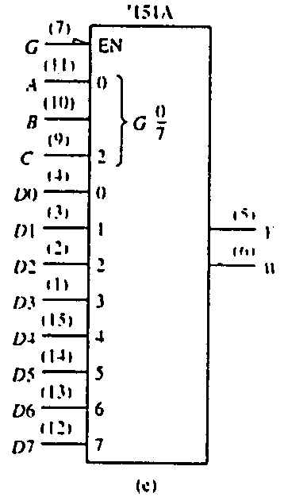
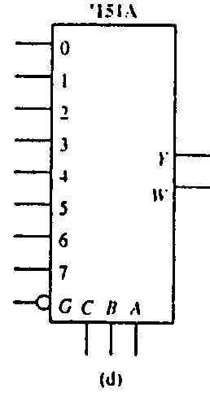
Standard MSI Multiplexer (2/2)
74151A 8-to-1 multiplexer. (c) Logic diagram. (d) Generic logic symbol. (e) IEEE standard logic symbol.
Source: The TTL Data Book Volume 2. Texas Instruments Inc.,1985.
Lecture 3
Combinational Circuits: MSI Components

Slide 48
Multiplexers: Implementing Functions (1/3)
A Boolean function can be implemented using multiplexers.
A 2^{n}-to-1 multiplexer can implement a Boolean function of n input variables, as follows:
  (i) Express in sum-of-minterms form.
Example: F(A,B,C) = A'B'C + A'BC + AB'C + ABC'
= Σ m(1,3,5,6)
  (ii) Connect n variables to the n selection lines.
  (iii) Put a '1' on a data line if it is a minterm of the function, '0' otherwise.
Lecture 3
Combinational Circuits: MSI Components

Slide 49
Multiplexers: Implementing Functions (2/3)
F(A,B,C) = Σ m(1,3,5,6)
This method works because:
Output = m₀.I₀ + m₁.I₁ + m₂.I₂ + m₃.I₃ + m₄.I₄ + m₅.I₅ + m₆.I₆ + m₇.I₇
Supplying ‘1’ to I₁,I₃,I₅,I₆ , and ‘0’ to the rest:
Output = m₁ + m₃ + m₅ + m₆
0
1
0
1
0
1
1
0
0
1
2
3
4
5
6
7
F
mux
A B C
Lecture 3
Combinational Circuits: MSI Components

Slide 50
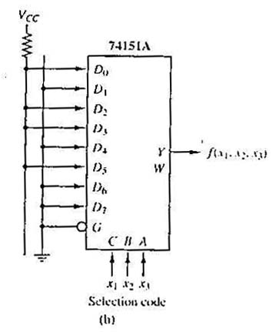
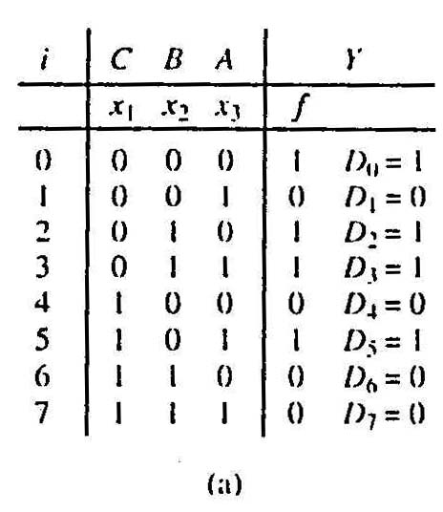
Multiplexers: Implementing Functions (3/3)
Example: Use a 74151A to implement:
f(x₁,x₂,x₃) = ∑ m(0,2,3,5)
Realization of f(x₁,x₂,x₃) = ∑m(0,2,3,5).
(a) Truth table.
(b) Implementation with 74151A.
Lecture 3
Combinational Circuits: MSI Components

Slide 51
Using Smaller Multiplexers (1/6)
Earlier, we saw how a 2^{n}-to-1 multiplexer can be used to implement any Boolean function of n (input) variables.
However, we can use a single smaller 2^{(n-1)}-to-1 multiplexer to implement any Boolean function of n (input) variables.
In particular, the earlier function
F(A,B,C) = ∑ m(1,3,5,6)
can be implemented using a 4-to-1 multiplexer (rather than an 8-to-1 multiplexer).
Lecture 3
Combinational Circuits: MSI Components

Slide 52
Using Smaller Multiplexers (2/6)
Let’s look at this example:
F(A,B,C) = Σ m(0,1,3,6) = A’B’C’ + A’B’C + A’BC + ABC’
A’B’
1
1
0
1
0
0
1
0
0
1
2
3
4
5
6
7
1
C
0
C'
0
1
2
3
F
mux
F
mux
A B C
A B
Note: Two of the variables, A, B, are applied as selection lines of the multiplexer, while the inputs of the multiplexer contain 1, C, 0 and C'.
Combinational Circuits: MSI Components

